Slide 1
UAF Experience:
Effectiveness, Toxicity and Biodegradation of Dispersants and Dispersed oil under Arctic Conditions.
INE, Dr. Robert A. Perkins, PE
IAB, Dr. Mary Beth Leigh
Kelly McFarlin, M.S.

Slide 2
Overview UAF Toxicology and Oil Spill Related Research
Intro Dispersants and Oil Spills
INE tox testing
    CROSERF
    Creosote
    Barrow JIP
IAB Biodegradation
    Barrow
    Future
Use of Data in Decision-Making
Partners and Friends

Slide 3
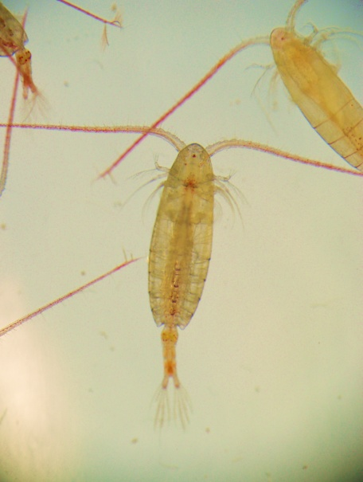
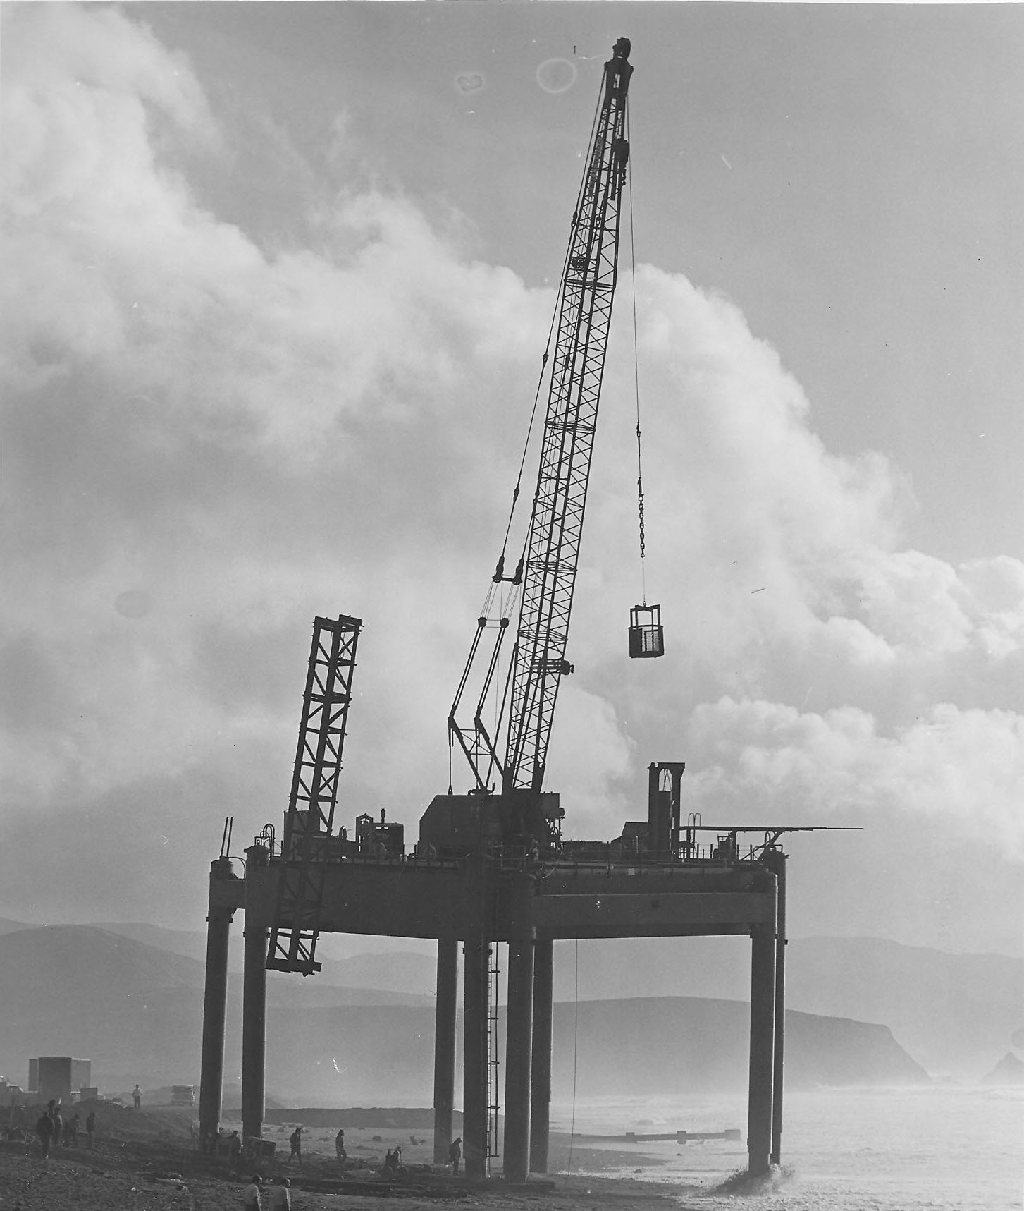
INE
IAB

Slide 4
Oil Spills and Dispersants
“After oil is spilled, nothing good happens.”
Mechanical Recovery
In situ Burning
Mechanical (Natural) Dispersion
Chemical Dispersion

Slide 5
HOW DISPERSANTS WORK
THE GOAL: REDUCE OIL CONCENTRATION TO LESS THAN IMPACT LEVELS AS RAPIDLY AS POSSIBLE

Slide 6
Why do small oil droplets float more slowly than large oil droplets ?
STOKES LAW
Δh/t = D²(ρ_{w} - ρ_{o})g
18η_{w}
Small oil droplets rise much more slowly than large droplets
Slide Courtesy of Alun Lewis

Slide 7
Effectiveness
Type of oil
Weathering state
Sea state and weather conditions
Generally published for major dispersant formulations
UAF has done standard lab tests on these
Meso-scale tests are common

Slide 8
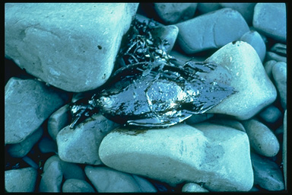
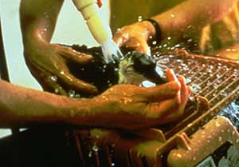
Removes Oil from Surface

Slide 9
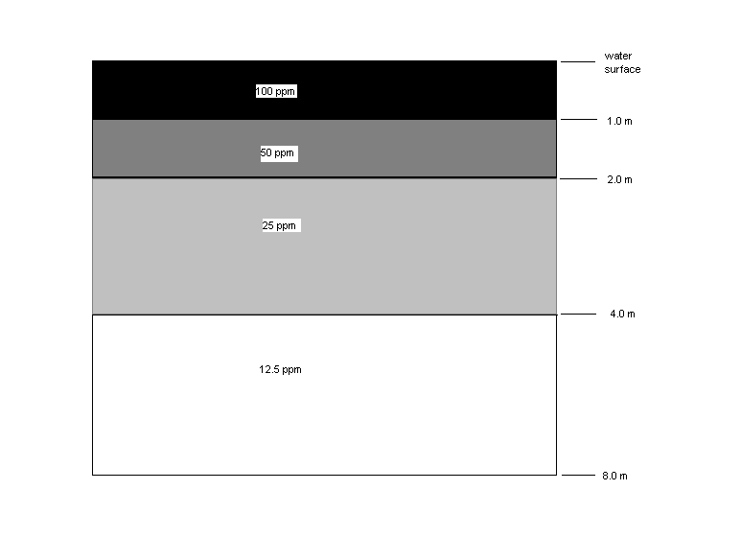
Puts oil into the water column
Fig. 1-9. Concentrations of oil in the water column following dispersal of a 0.1 mm thick slick of fresh oil treated with a chemical dispersant (Lewis and Aurand, 1997)

Slide 10
Are Dispersants Toxic?

Slide 11


Slide 12
Scientific toxicology
  Seeks to understand the natural laws regarding effects
Applied toxicology
  Seeks to establish safe doses (concentrations)

Slide 13
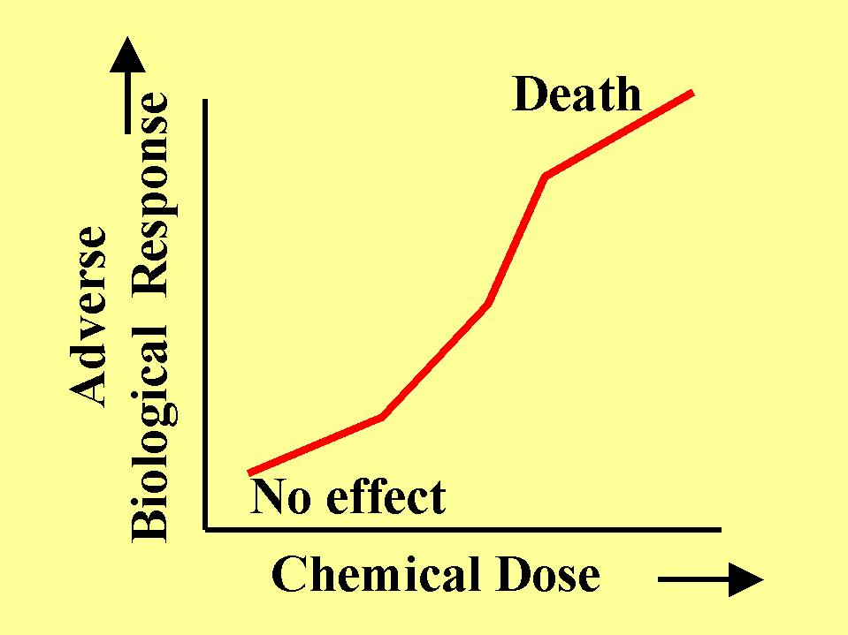
http://info.lu.farmingdale.edu/depts/met/ind310/industrialtoxicology.html

Slide 14
LC50?
Method of comparing chemicals and situations
Modeling

Slide 15
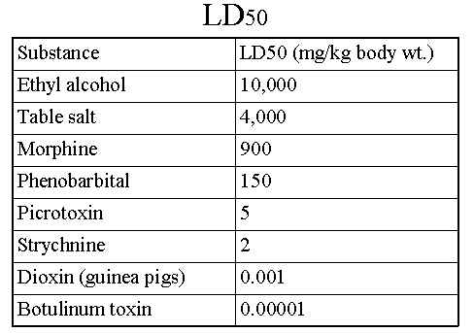

Slide 16
DISPERSION EFFECT
OF THE WATER COLUMN
Water Currents Distribute Oil Over Wide Area

Slide 17
OK, but
Are dispersants toxic?

Slide 18
CROSERF
Chemical Response to Oil Spills: Ecological Effect
Research Forum
Boxes of Literature
No standardized :
  Oil
  Weathering state
  Dispersant
  Dosing rate or method
  Analysis
  Species
  Mixing

Slide 19
State Environmental and Resource Agencies
  Texas General Land Office (TGLO);
  Florida Department of Environmental Protection (FL DEP);
  California Office of Oil Spill Prevention and Response (CA OSPR);
  Alaska Department of Environmental Conservation (ADEC);
Federal
  Minerals Management Service (MMS);
  U.S. Environmental Protection Agency (EPA), and
  Industry
  Exxon Corporation;
  Chevron Corporation
  American Petroleum Institute (API), and
  Marine Spill Response Corporation (MSRC).
  Universities
  University of California, Santa Cruz (later UC Davis)
  University of South Florida
  Texas A&M University
  University of Alaska Fairbanks

Slide 20
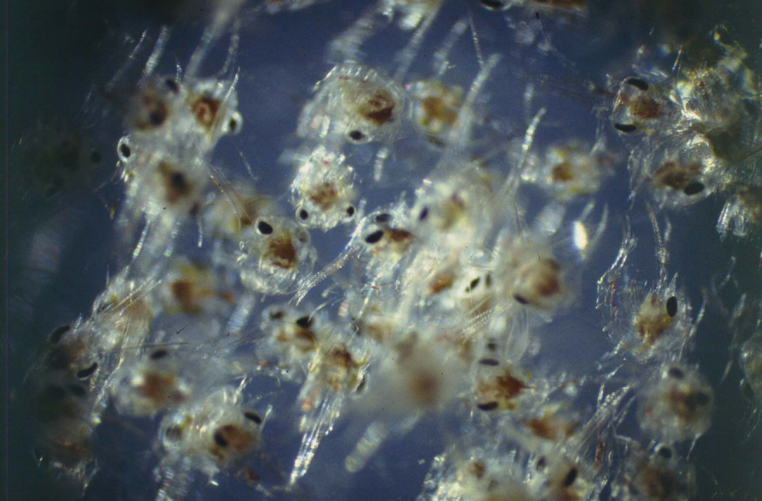
CROSERF Testing
Standard species and standard oil
  Calibrate labs
Standard species and local oil
  Is our oil different?
Local species and local oil
  Are our local
  species different?

Slide 21
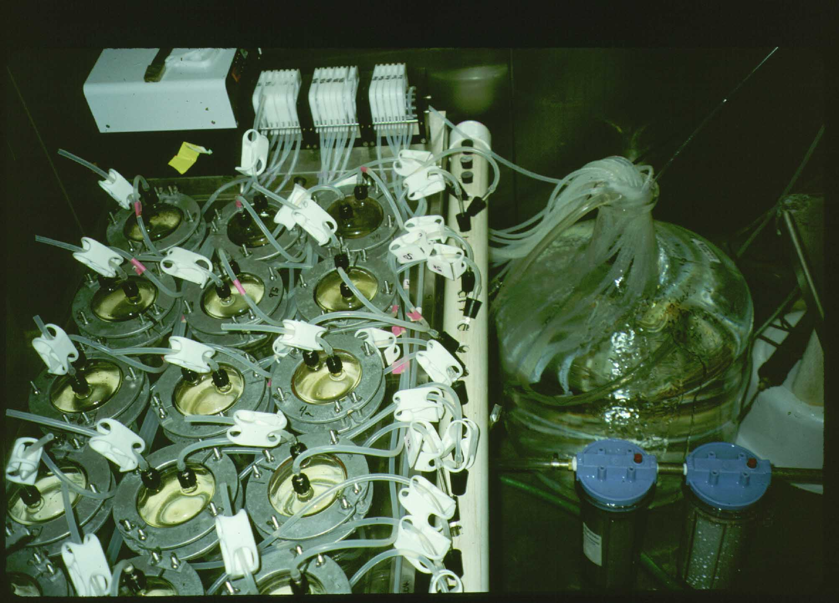

Slide 22
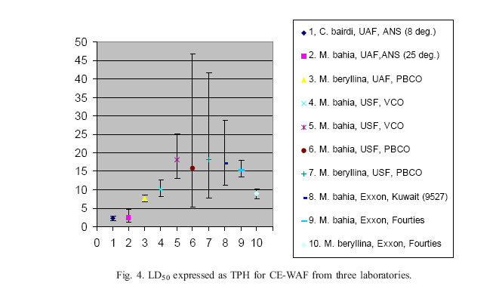
Fresh CE-WAF

Slide 23
Eco Tox Testing Goals
Test relevant species
Sensitive life stage
As close to environment conditions beneath a spill
Establish dose-response
Input to modeling environmental effects

Slide 24
Test Species
Whales to microorganisms
Best would be convenient and relevant,
Convenient - amenable to laboratory testing
Relevant - important to the ecosystem in question, recognized by the public, sensitive to the chemical.
“Standard” test species
  All warm, 20 C, water

Slide 25
Creosote Timber Research
Southeast Alaska
Sponsor Alaska DOT&PF
Is Creosote toxic to herring eggs?
Partners
    UAS
    NOAA Fisheries

Slide 26
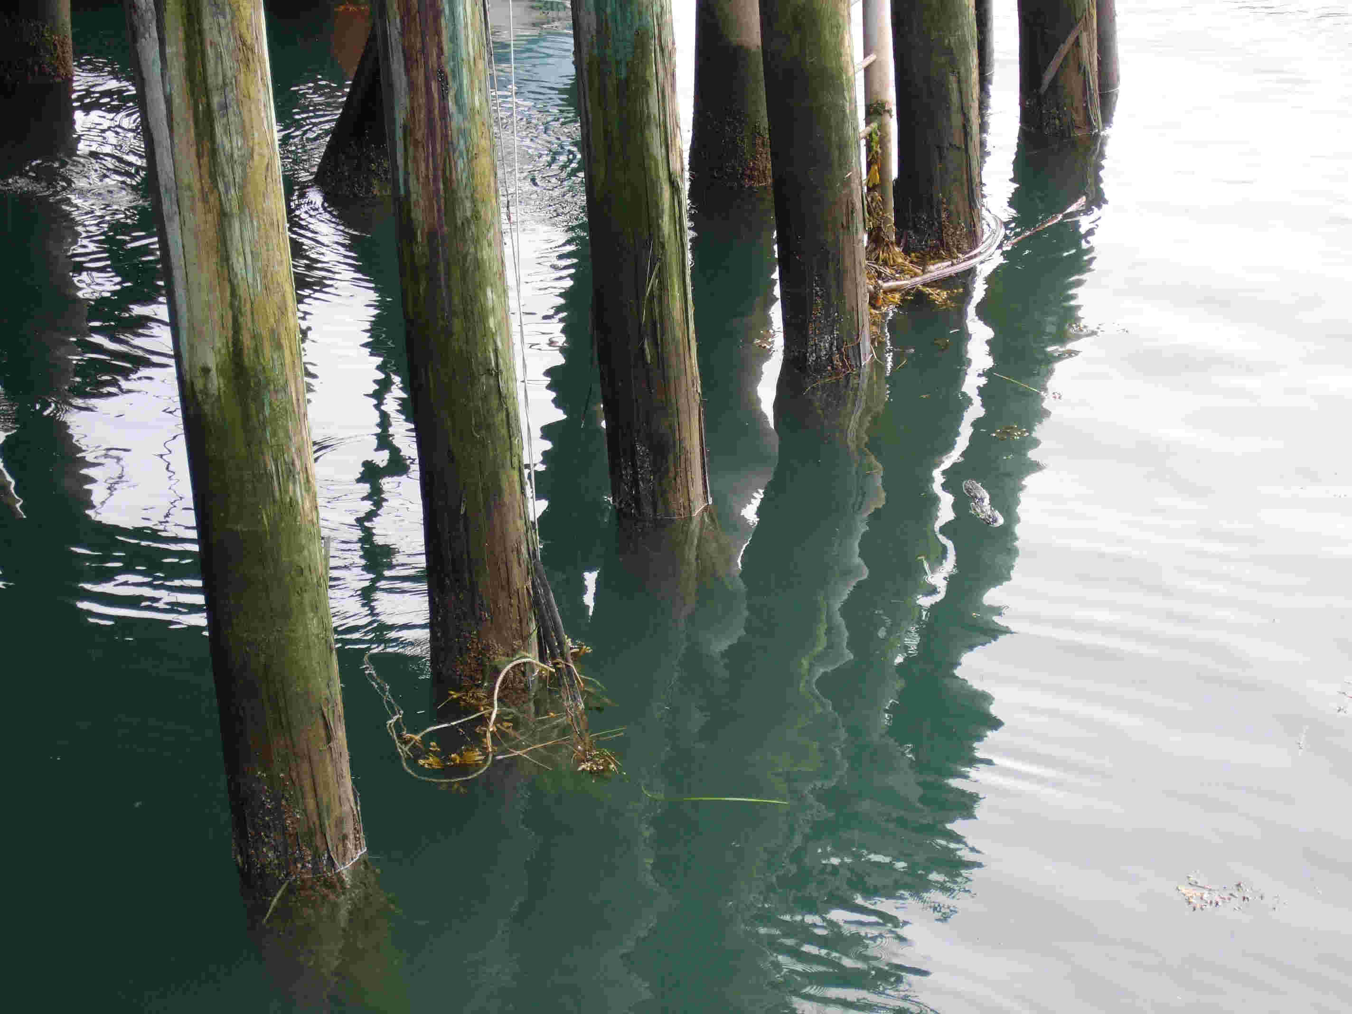
ACZA Piles

Slide 27
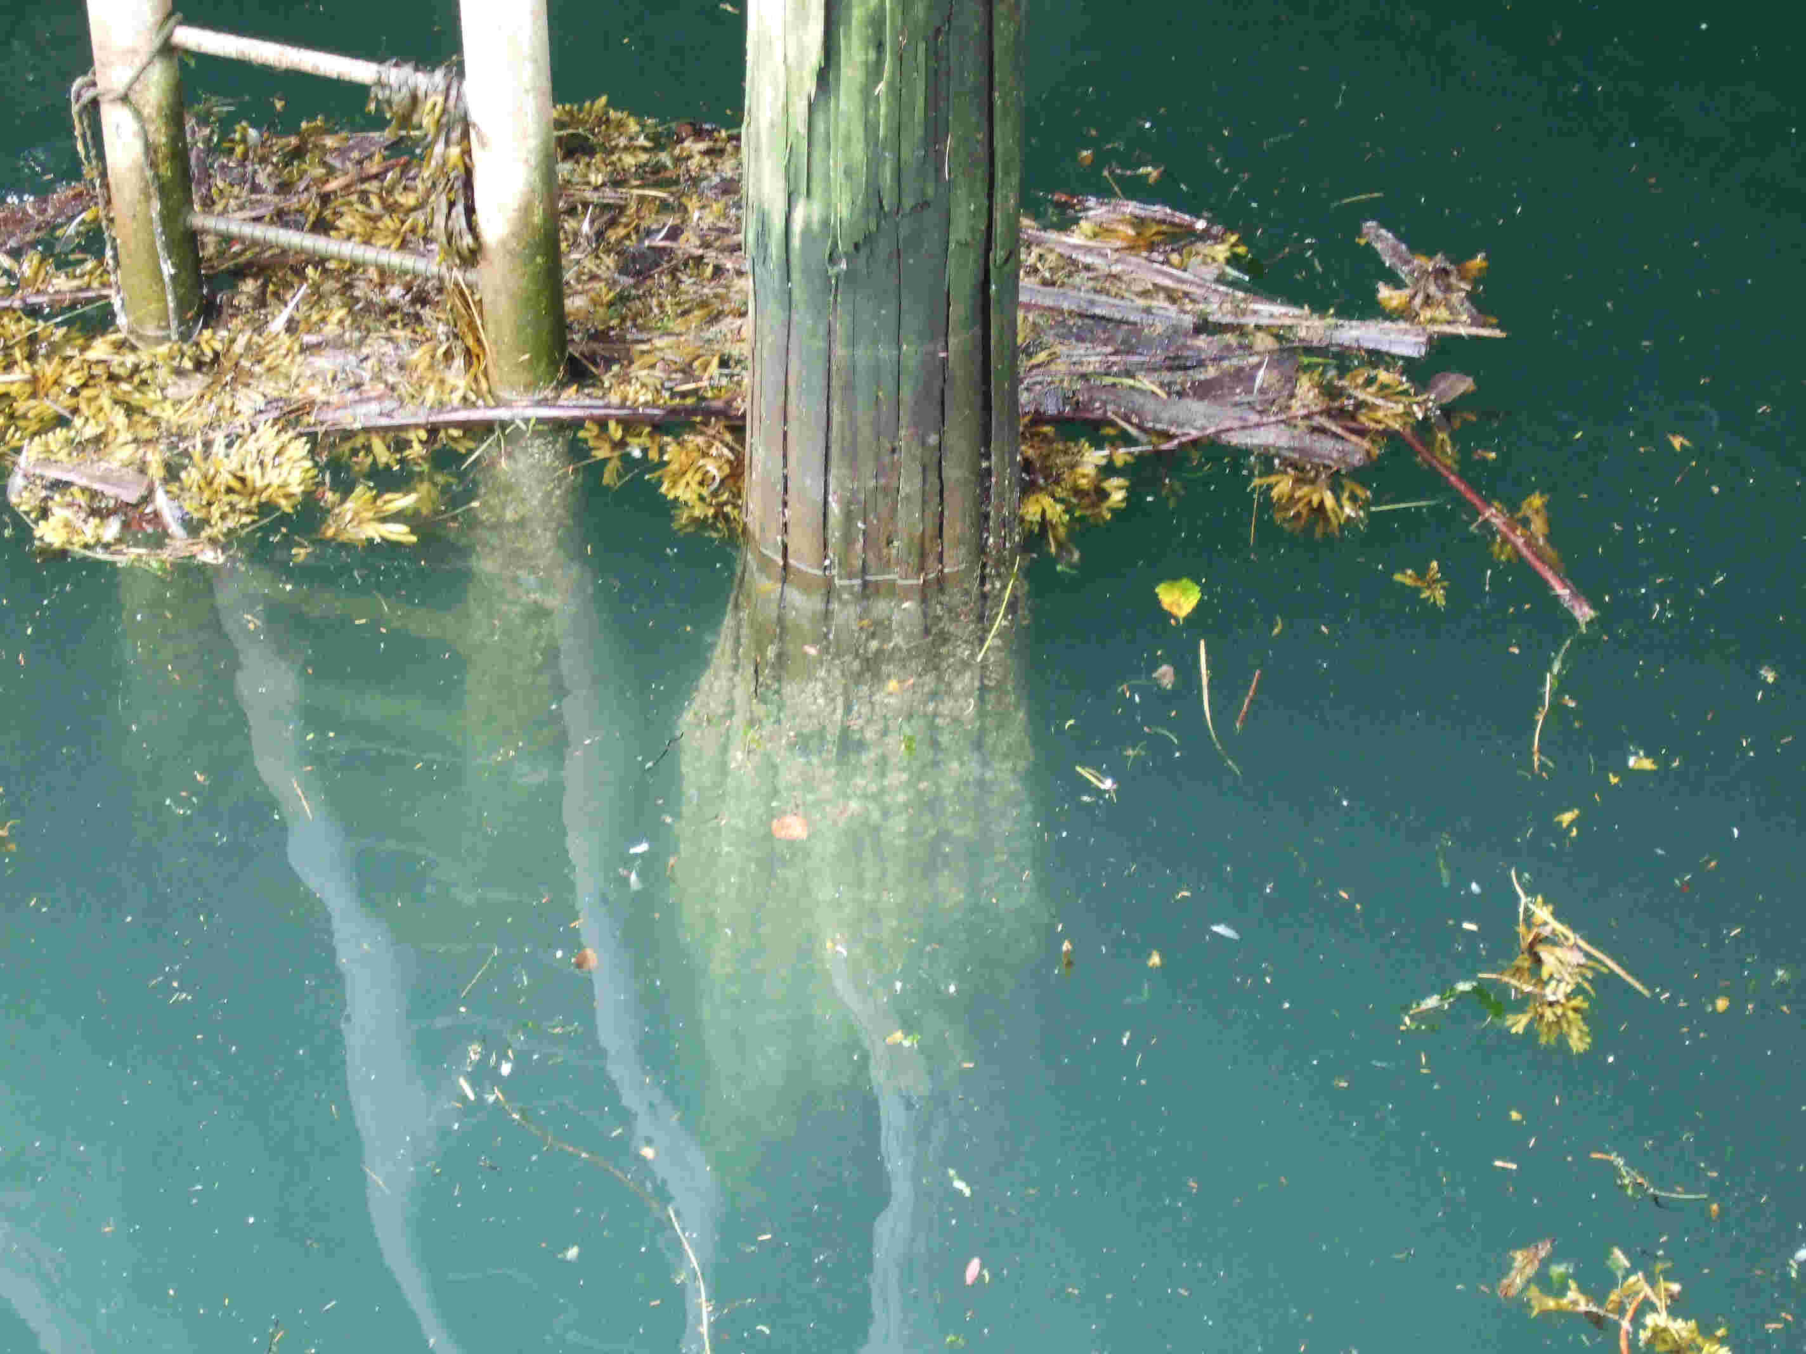

Slide 28
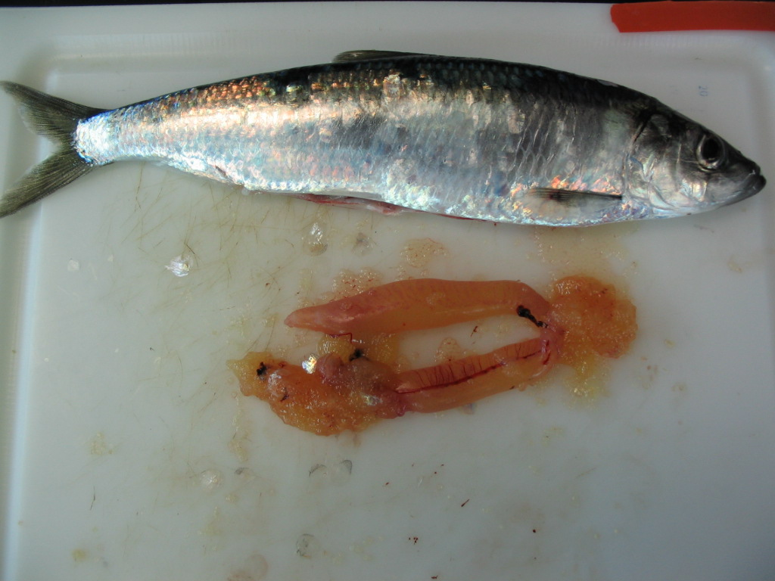

Slide 29
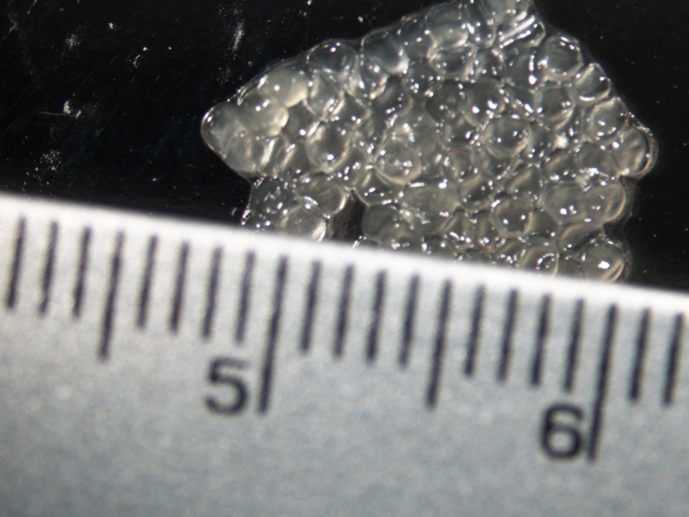

Slide 30
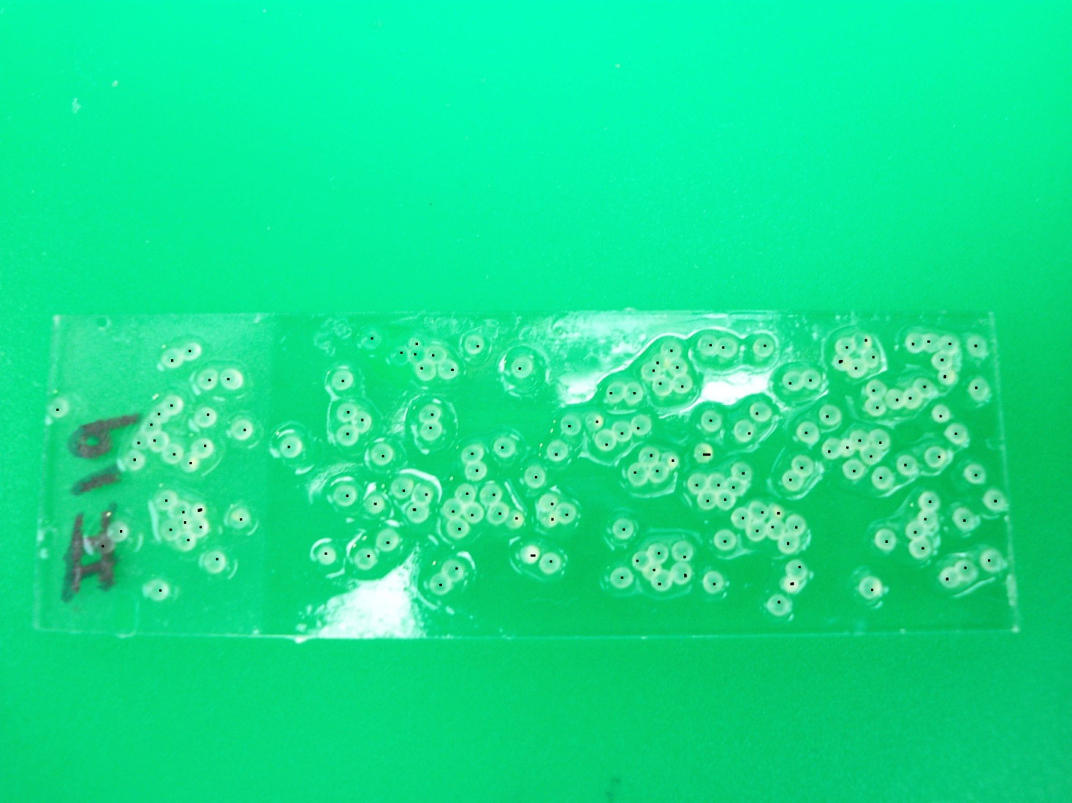

Slide 31
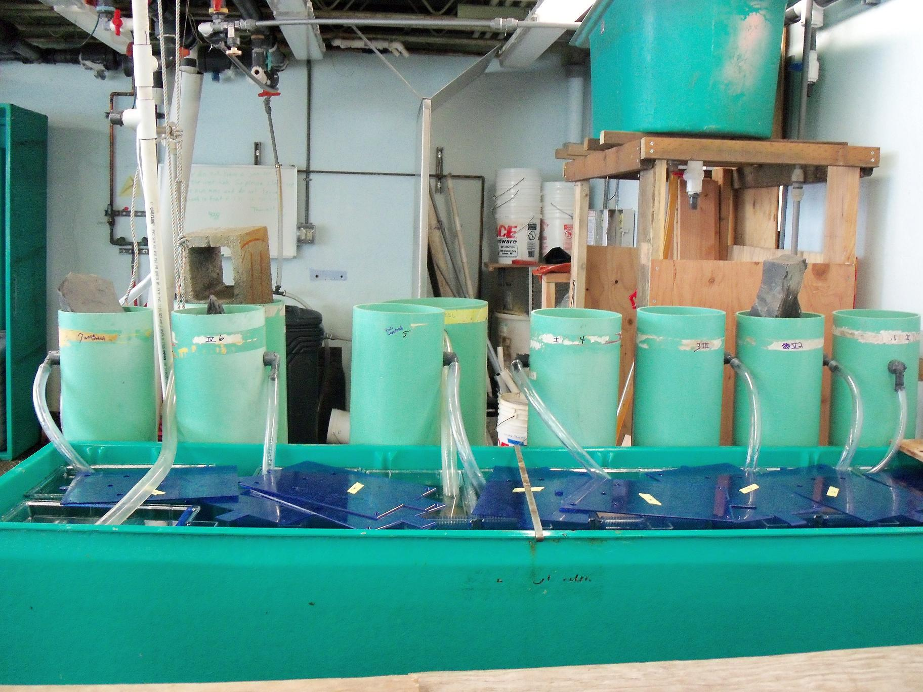

Slide 32
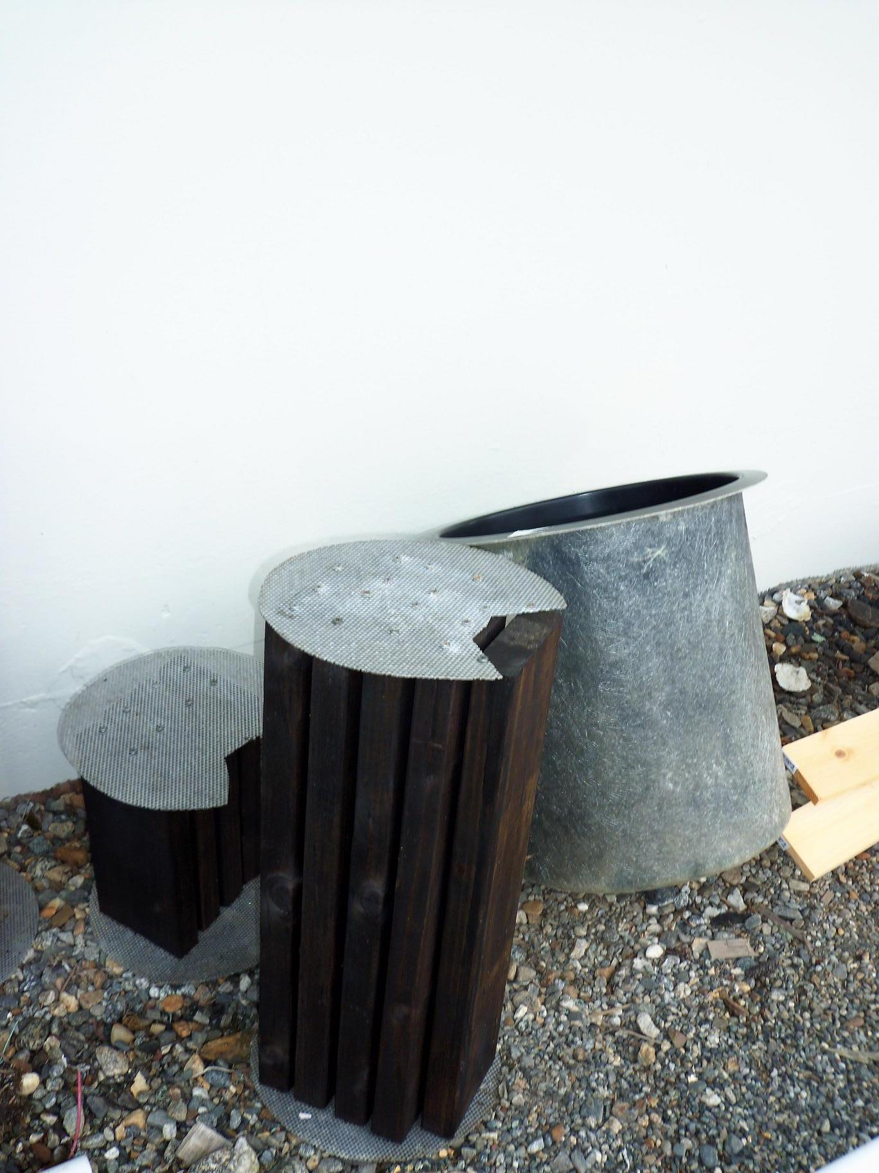

Slide 35
Evaluating the Biodegradability and Effects of Dispersed Oil using Arctic Test Species and Conditions
Kelly McFarlin, Mary Beth Leigh, and Robert A. Perkins
University of Alaska Fairbanks
Fairbanks, Alaska, USA
Jack D. Word and William W. Gardiner
NewFields Northwest
Port Gamble, WA, USA
Notes:
As oil exploration efforts continue in the Arctic, it becomes important to understand the efficiency and effects of current oil spill response options. Today I’m going to be talking about a research program that was developed in order to evaluate the use Corexit 9500 (the same chemical dispersant that was used in the Gulf of Mexico), as an oil spill response option in Arctic open water environments. My presentation is titled:

Slide 36
Introduction
Main Objective
  Obtain site-specific data to estimate and compare environmental risks associated with the use of chemical dispersants in the arctic
Specific Objectives
  1. Determine the toxicity of chemically dispersed Alaska North Slope (ANS) crude oil compared to physically dispersed oil
  2. Determine the biodegradation of chemically dispersed oil compared to physically dispersed oil
Notes:
There main objective of this study:
To accomplish this it is important to determine:

Slide 37
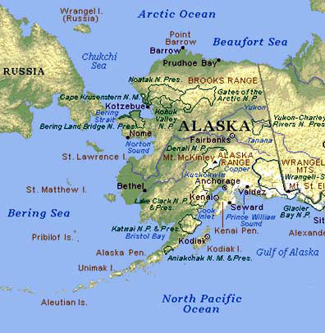
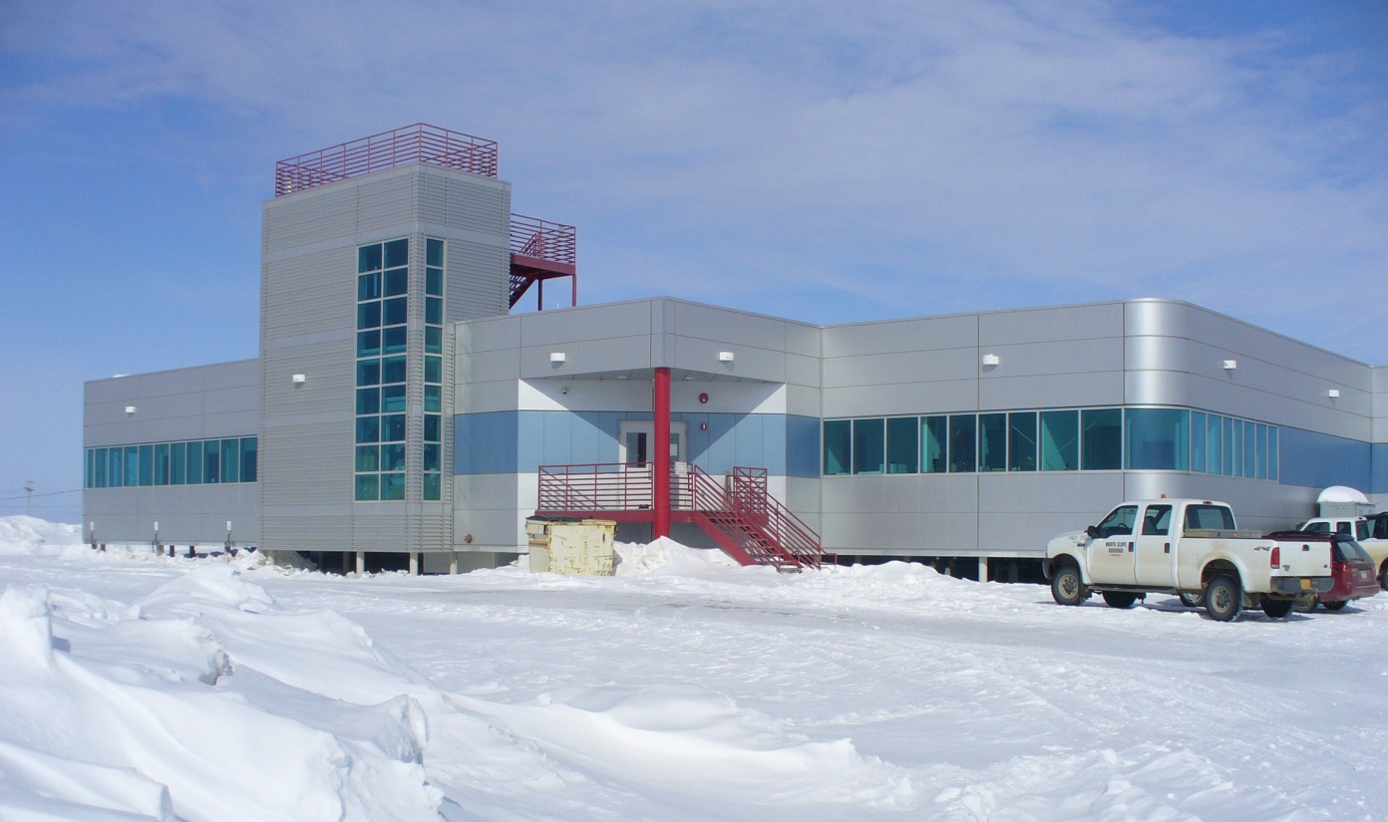
Barrow Laboratory
The Barrow Arctic Research Center, Barrow, Alaska
Notes:
These experiments were carried out in a laboratory and cold room testing space leased from the Barrow Arctic Sciences Consortium (BASC) located in Barrow, Alaska. Staff from the University of Alaska Fairbanks (UAF) conduct the field and laboratory activities, with oversight and support provided by NewFields Northwest.
All field activities were conducted in either the Chukchi or Beaufort Seas, adjacent to Point Barrow.

Slide 38
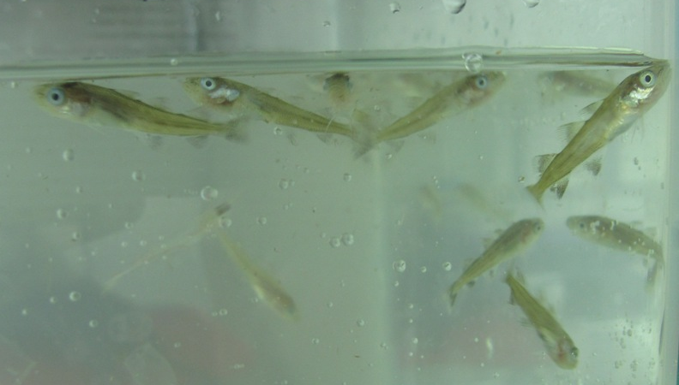
Arctic Cod (Boreogadus saida)

Slide 39
Copepod (Calanus glacialis)

Slide 40
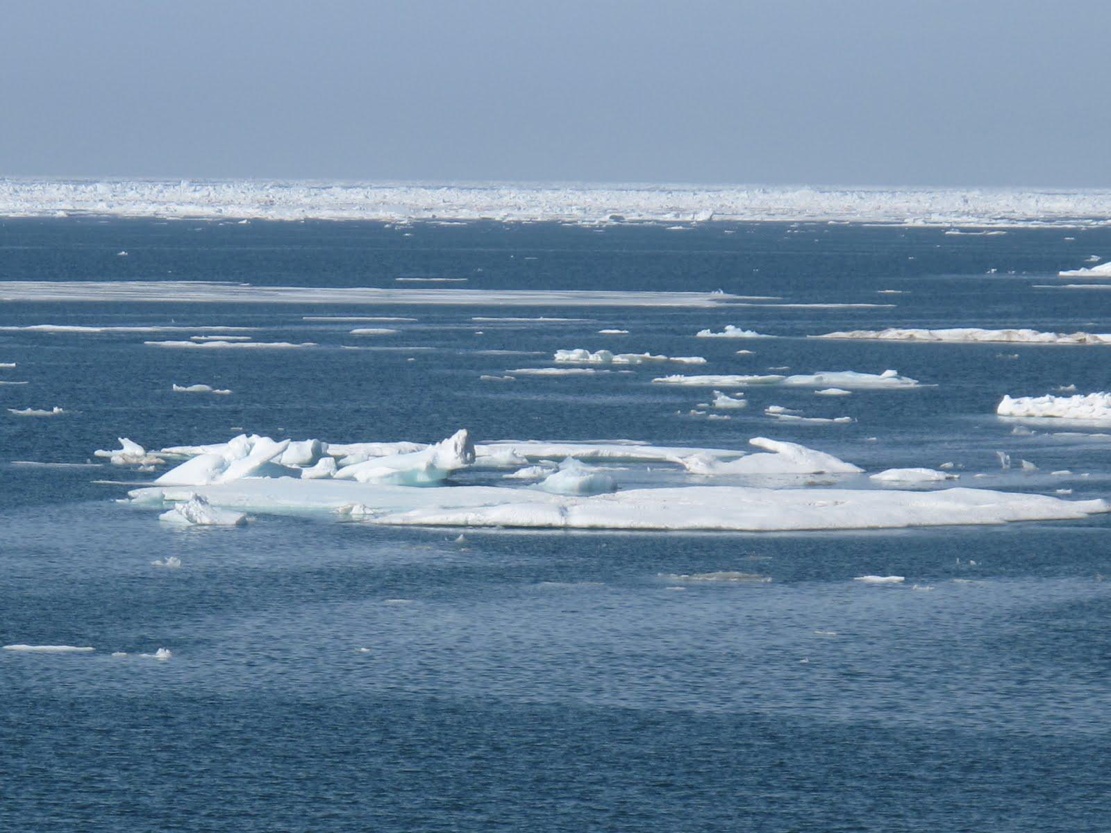
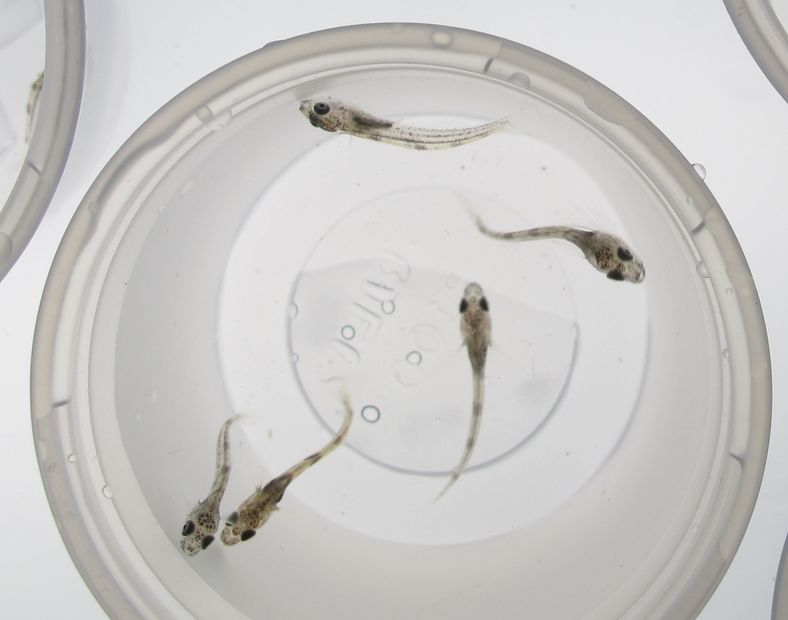
Sculpin (Myoxocephalus sp.)

Slide 41
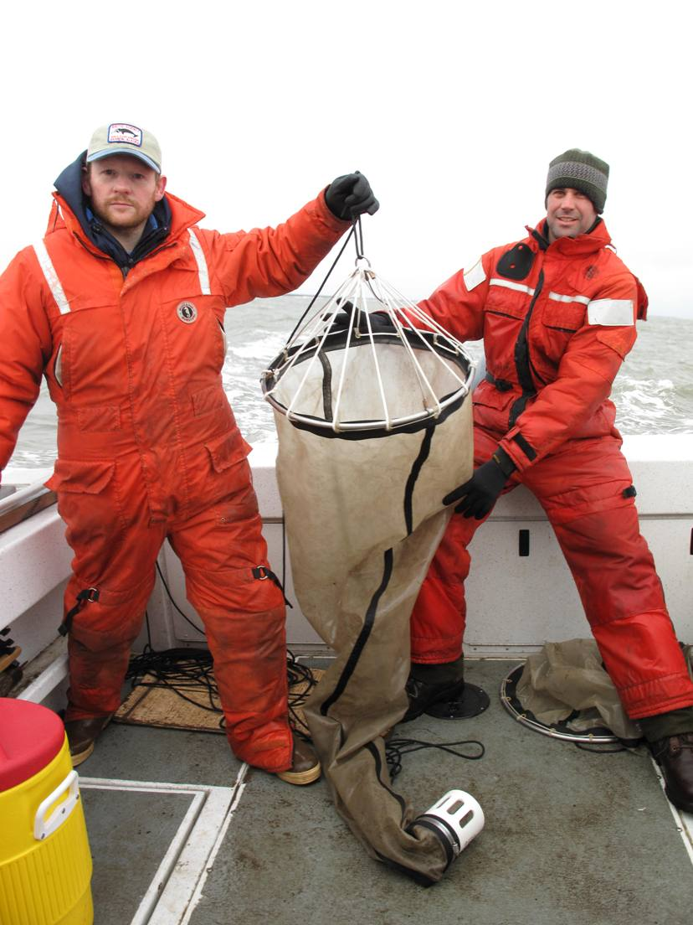
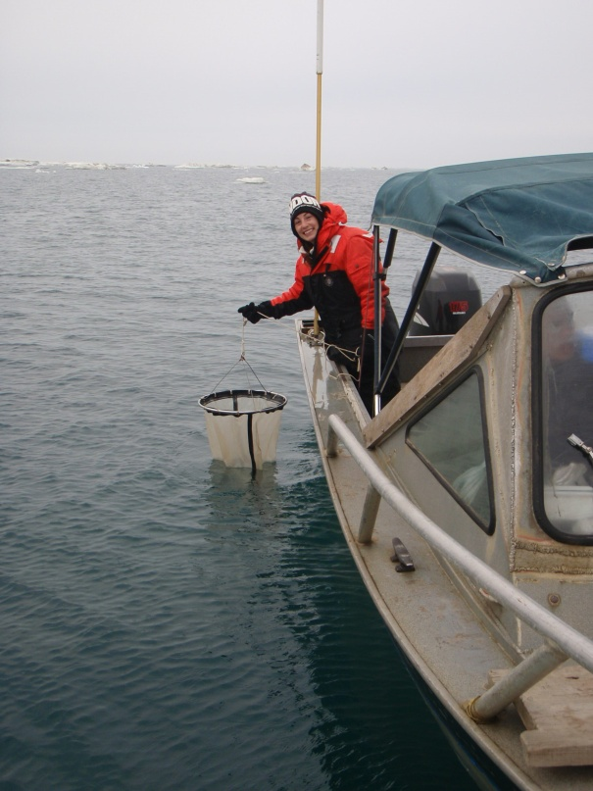
Copepod Collection
Notes:
Copepods are planktonic organisms and are carried by ocean currents. Copepods were all caught using a small plankton nets. These nets are conical in shape and attached to a stainless steel ring that keeps the mouth of the net open. The other end of the net contains a collection chamber where the sample becomes concentrated.
During open water conditions, copepods were collected with vertical tows adjacent to floating ice bergs as well as tows behind a boat.

Slide 42
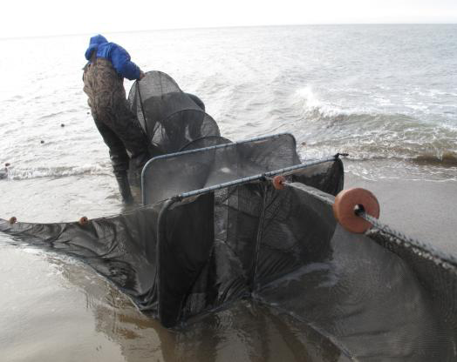
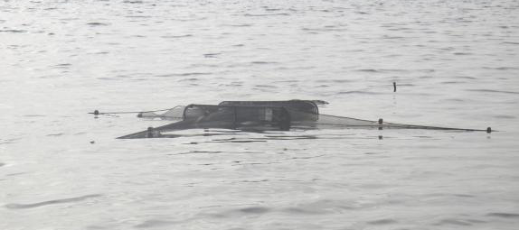
Summer Arctic Cod Collection
Notes:
Juvenile arctic cod (100-130 mm) were collected using a fyke-net.
A Fyke net is a static net that is positioned perpendicular to the shore with wings that are stretched out parallel to the beach. Fish that run the shoreline are funneled into the net consisting of a series of ring traps that make it difficult for the fish to exit.

Slide 43
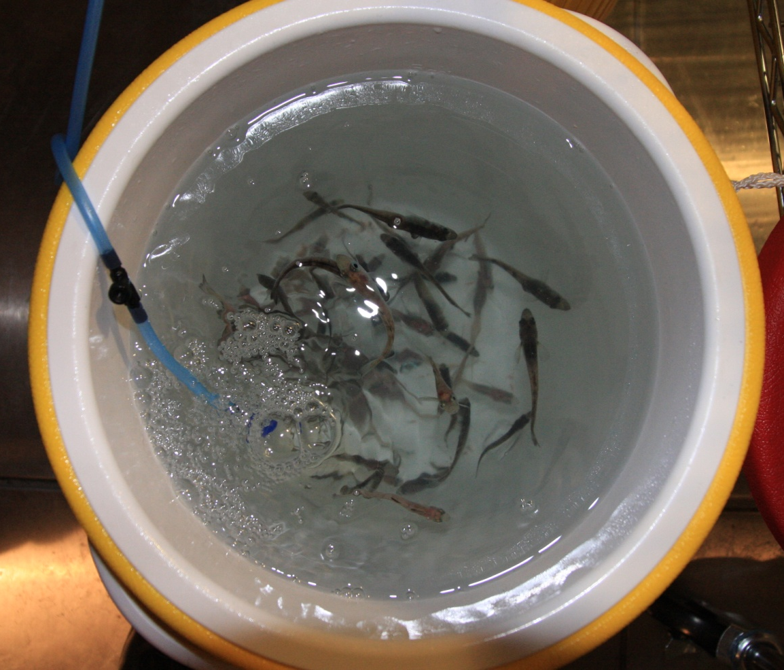
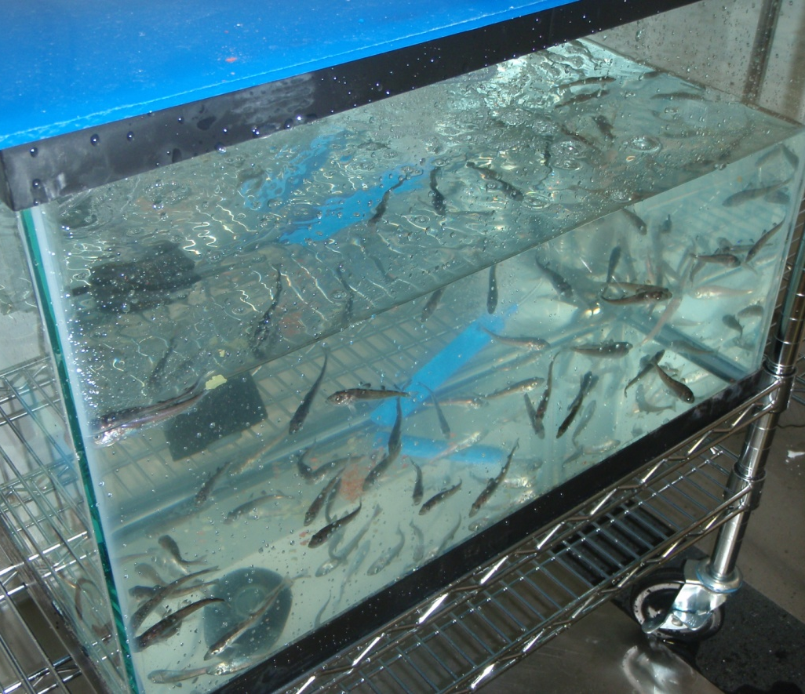
Culture Maintenance
Notes:
Organisms were transferred to the lab in coolers and allowed to slowly acclimate to the cold room temperature. Once acclimated, the organisms were transferred to aerated 10 gallon aquariums containing 80% filtered seawater and 20% fresh non-filtered seawater. Water quality parameters were measured daily and cultures containing arctic cod were renewed with filtered seawater every other day, while copepod cultures were renewed once a week. Collected copepods were used to feed the arctic cod (and sculpin) cultures, while copepods were fed a phytoplankton suspension.

Slide 44
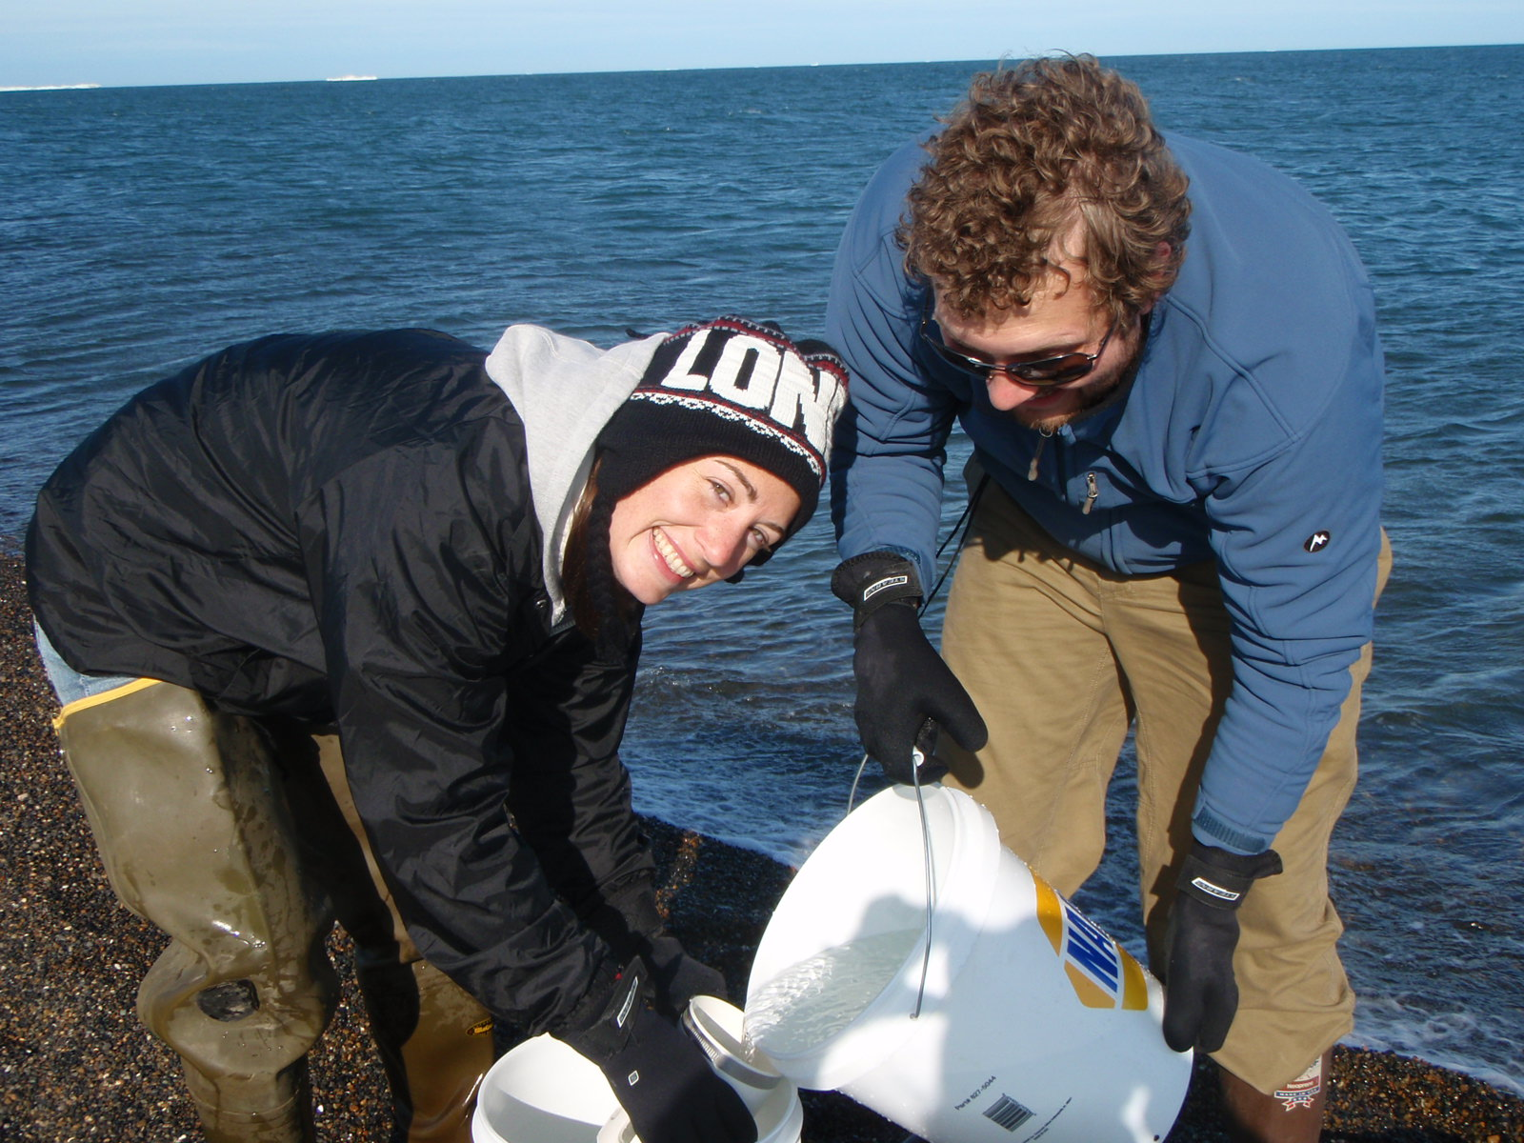
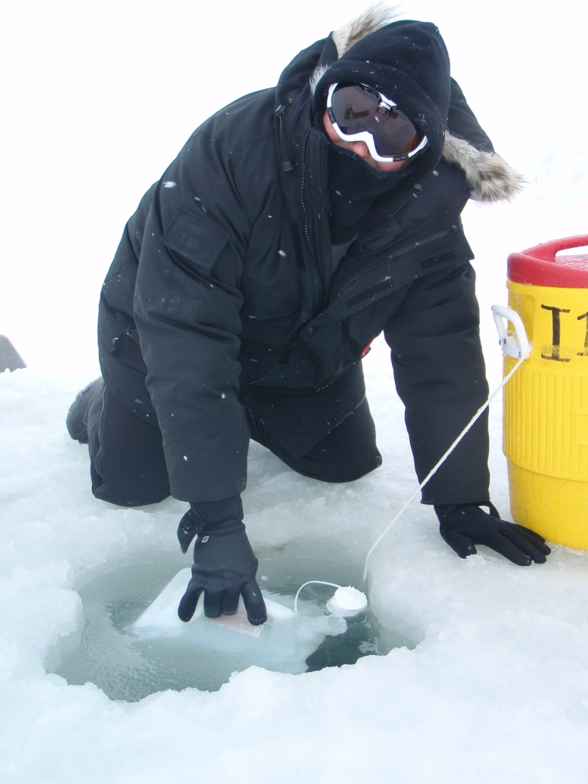
Water Collection
Notes:
All maintenance and renewal water was filtered Chukchi or Beaufort Sea water.
We had to collect a lot of water!!!!

Slide 45
Toxicity Testing
Chemically vs. Physically dispersed fresh ANS
Test Organisms: copepods, arctic cod and larval sculpin
Physically dispersed
  Water Accommodated Fraction (WAF)
  “Breaking Wave WAF” (BW-WAF)
Chemically dispersed
  Chemically-Enhanced Water Accommodated Fraction (CE-WAF)
Notes:
The Toxicity of chemically and physically dispersed oil was evaluated for three types of dispersed oil:
The physically dispersed petroleum preparations included a water-accommodated fraction (WAF) and a more energetic physical dispersion, which our group termed a “breaking wave WAF”.
The chemically-dispersed petroleum preparation, or chemically-enhanced WAF (CE-WAF), was prepared in a manner similar to the WAF, except with the addition of chemical dispersant.
Toxicity tests were conducted with these 100% WAF and CEWAF preparations and their dilutions.
There are many published papers on procedures to follow when making these WAF and CE-WAF solutions, I’ll do a brief overview of our methods.

Slide 46
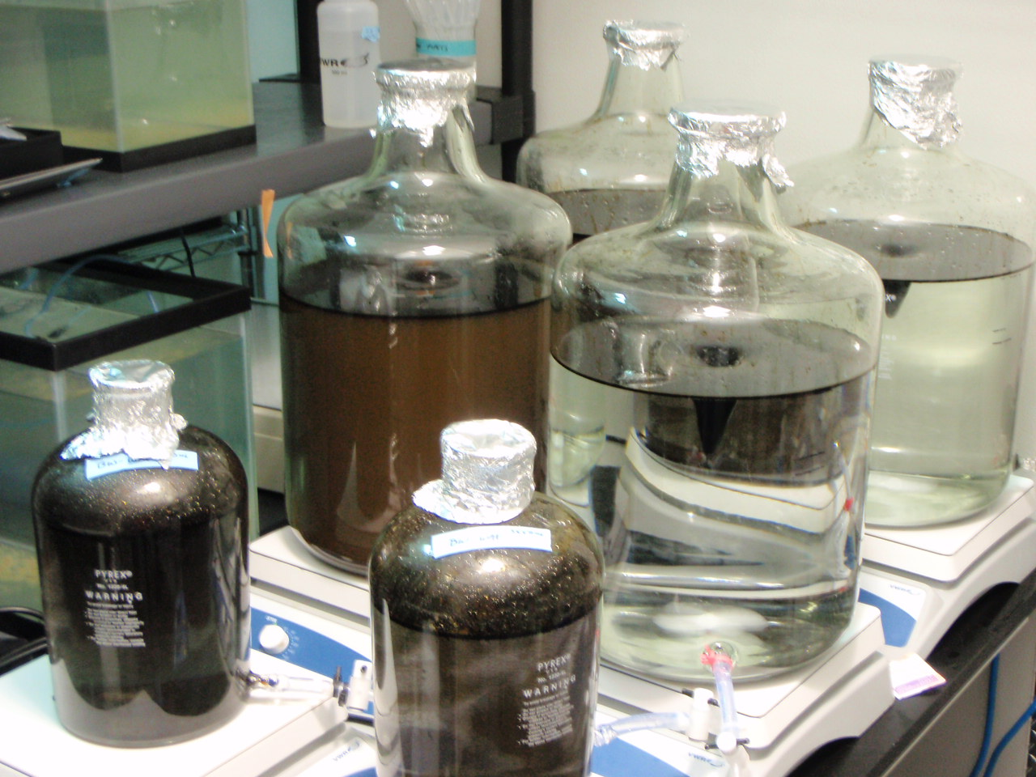
Toxicity Test Solutions
Notes:
Stock solutions of WAF, BW-WAF, and CE-WAF were prepared with a loading rate of 10 g of ANS per L of filtered seawater in aspirator bottles.
Teflon coated stir bars were used to create a mixing velocity at a rate that the vortex occupied 20% of the total depth of solution.
These 100% solutions were sampled from the bottom port of the aspirator bottle and diluted down to the desired concentration.
Concentration: 10 g fresh ANS crude oil / L
16L of aerated, 0.45-μm filtered seawater, with 20% headspace in aspirator bottles
Teflon coated stir bars, at a rate that produced a 20% vortex
Stirred for 18 hours in the dark at 2°C, then allowed to settle for 6 hours

Slide 47
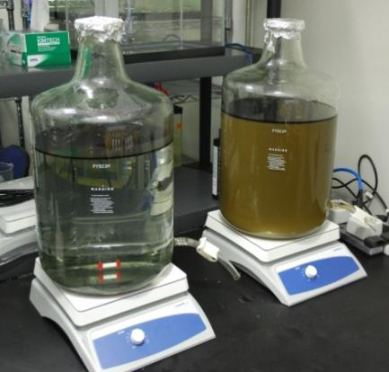
Toxicity Test Solutions
Notes:
The BW-WAF was prepared in a manner similar to the WAF. However, following the addition of petroleum, the contents of the aspirator were mixed by gently rocking the aspirator for 30 seconds every 15 minutes, for the first two hours of the 18 hour mixing period.
For the CE-WAF preparation, Corexit 9500 was added at a dispersant to oil ratio (DOR) of 1:20.
In order to address questions concerning the toxicity of Corexit 9500, an additional dispersant-only treatment was prepared for testing with copepods using the same dispersant loading rate as the CE-WAF.
BW-WAF: manually agitated for 30 seconds every 15 minutes for the first 2 hours.
CE-WAF: Dispersant to Oil ratio (DOR) 1:20, 0.5g/L
Corexit 9500
Dispersant only treatment: 0.5 g/L

Slide 48
96 hour Toxicity Tests
“Spiked exposure”: initial dosing followed by renewal with clean seawater
Simulates natural mixing
4 hour half life: initial dose half its concentration after 4 hours
After 96 hours, organisms transferred to clean seawater and observed for 8 to 20 days.
Notes:
**We conducted a 96 hour spiked exposure test, based upon CROSERF methods. Meaning that the initial concentration of oil is continuously diluted, until 96 hours. At 96 hours, test organisms were transferred to clean seawater and held for an additional observation period to account for any delayed responses. During the 96 hour test, clean sea water was pumped into each chamber, at a rate such that the entire volume of oily water was replaced with fresh clean seawater after 8 hours. This is to simulate organisms swimming underneith a plume of oil (or through dispersed oil) and the subsequent dilution that occurs under natural conditions as the organisms continues to swim onward.
Tests were conducted in open systems to allow for volatilization, as would occur naturally.

Slide 49
Toxicity Test Chemistry
Actual TPH and TPAH was determined for each test solution by GC/MS analysis.
Production of WAF and CEWAF in cold water is highly dependent upon the efficiency of mixing
Use of “Loading rate” or “Nominal Concentration” is not recommended.
Notes:
Chemical analysis is critical to understanding the toxicity of CEWAF and WAF. While many studies report results based on nominal concentrations, we found substantial variability when comparing nominal concentrations to chemical analysis.
Although, the dilutions of the 100% solution were highly predictable, when the chemical analysis was known.
Therefore it is recommended to measure at least the concentrations of the petroleum components in the 100% WAF, BWWAF or CEWAF preparations.

Slide 50
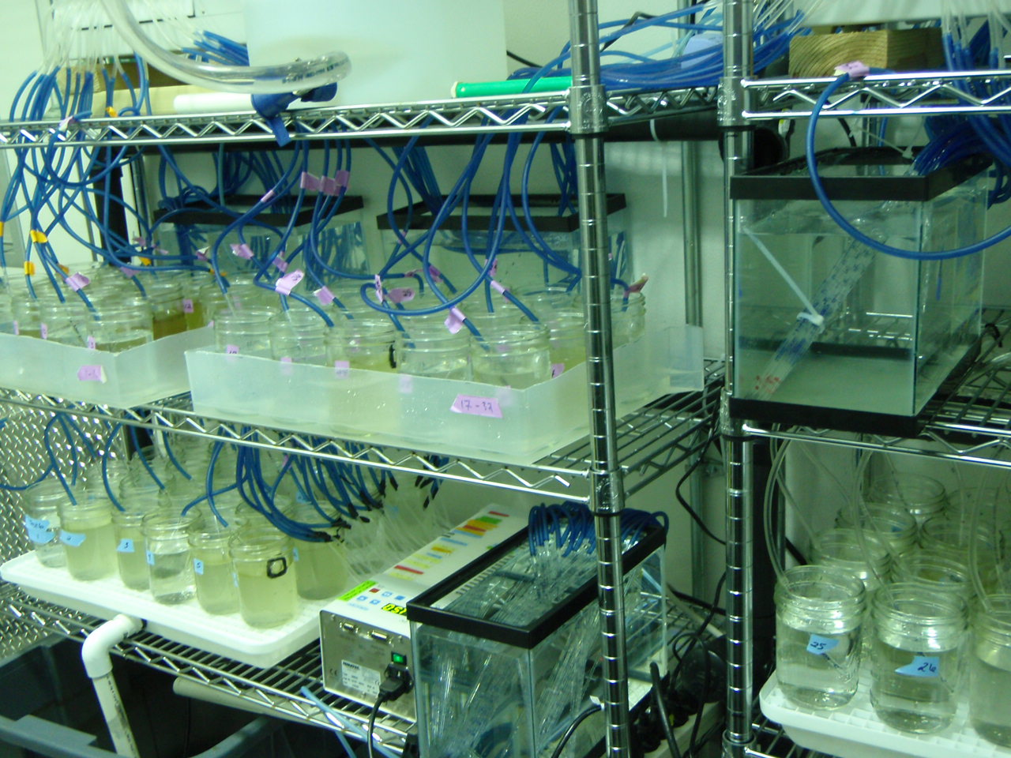
Toxicity Testing: Copepod
Notes:
All toxicity tests were conducted in a temperature controlled room at 2°C (±1°C). Temperature, Dissolved oxygen, salinity, and pH were monitored daily as well as mortalities.

Slide 51
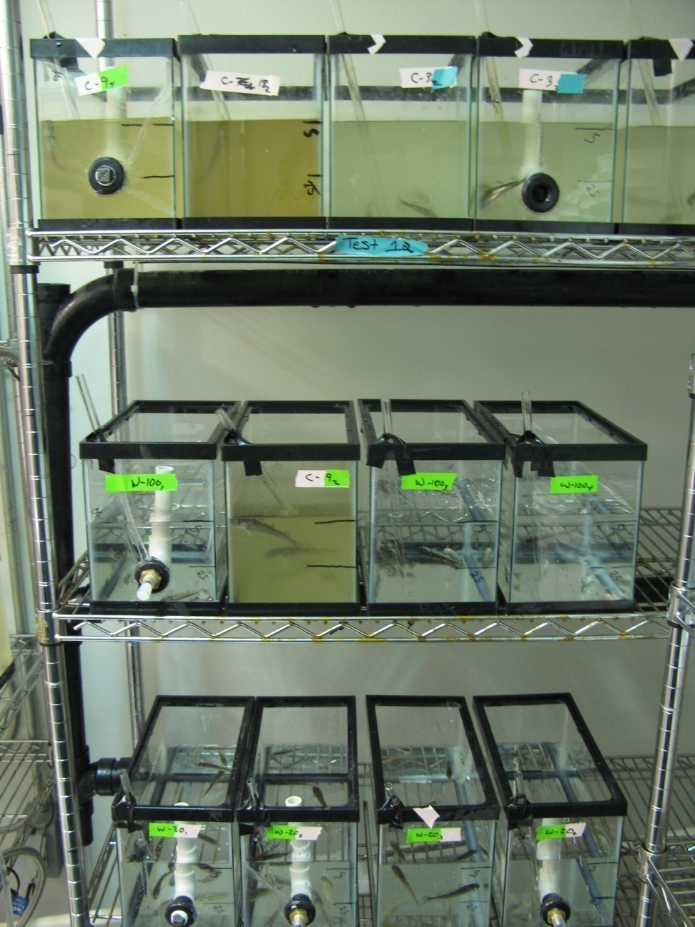
Toxicity Testing: Arctic cod

Slide 52
Toxicology Results
Notes:
Toxicity in the copepod test varied between the early and late season copepods (Table 1). For early season copepods, the mean of the CE-WAF concentration lethal to 50% of the test organisms (LC₅₀) was 22 mg/L TPH. Late season copepods were less sensitive to CE-WAF with a mean LC₅₀ of 62 mg/L TPH. LC_{50s} for the WAF were not calculable because there was insufficient TPH (<1.0 mg/L) in the water column to elicit a response.
For larval sculpin the mean LC₅₀ of CE-WAF was 27 mg/L TPH. Juvenile Arctic cod were less sensitive to CE-WAF than larval sculpin with a mean LC₅₀ of 55 mg/L. As with copepods and sculpin, the Arctic cod LC_{50s} for physically dispersed oil were substantially lower than those of the chemically dispersed petroleum.

Slide 53
Discussion
Expressed as TPH, CE WAF is 5 to 10-fold less toxic than WAF or BW-WAF
Consistent with other studies, including CROSERF
Implies that while chemical dispersion puts more oil in the water, it is somehow less toxic on a per unit of oil basis – TPH
    Introduction of less soluble and less acutely toxic oil components with chemical dispersion
    Less bioavailable, sequestered in micelles
    Research question

Slide 54
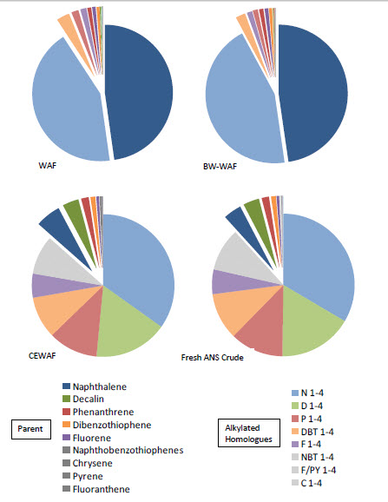
Notes:
The composition of PAHs in the physically dispersed petroleum was consistent across the test batches and was dominated by naphthalene (44% of the TPAH) and alkylated naphthalenes (40% of the TPAH; Figure 3-7). Small amounts of methylfluorene and methylphenathrene were also present. The addition of dispersant dramatically shifted the composition of the PAHs. With the exception of naphthalene (7%) and decalin (5%), the parent compounds were virtually absent. The alkylated naphthalenes accounted for one-third of the TPAH. Alkylated decalins, fluorenes, phenanthrenes, and dibenzothiophenes represented an additional 65% of the TPAH. High-molecular-weight PAHs (HMWPAH) were either absent or present at very low concentrations. The PAH distribution in the chemically-dispersed petroleum was very similar to that of fresh ANS crude, which was also dominated by the alkyl homologs of lower-molecular-weight PAHs.
Couillard et al. (2005) also observed that PAH distribution was altered with the addition

Slide 55
Toxicity Results Summary
Tested species are comparably sensitive to temperate species when exposed to similar test conditions, (Aurand and Coelho, 2005).
Notes:
Per unit of oil in the WAF (dissolved) -

Slide 56
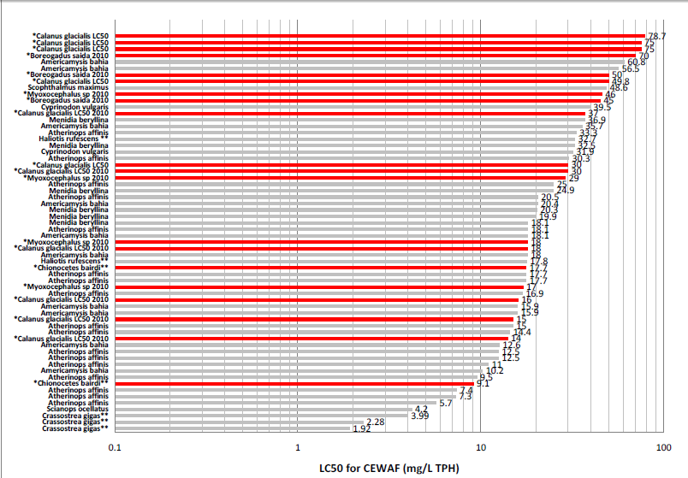

Slide 57
Use of Data
Provide Information
“Regardless of their effectiveness, questions remain regarding the potential toxicity and impacts of dispersants on Arctic ecosystems.” (National Commission on the BP Deepwater Horizon Oil Spill and Offshore Drilling)
“Microbes that degrade oil are not present in the Arctic” – testimony to Oil Spill Commission
Notes:
.” xii [National Commission on the BP Deepwater Horizon Oil Spill and Offshore Drilling. OFFSHORE DRILLING IN THE ARCTIC: BACKGROUND AND ISSUES FOR THE FUTURE CONSIDERATION OF OIL AND GAS ACTIVITIES Staff Working Paper No. 13 quoting from http://www.pewenvironment.org/news-room/reports/oil-spill-prevention-and-response-in-the-us-arctic-ocean-unexamined-risks-unacceptable-consequences-8589942645 ]

Slide 58
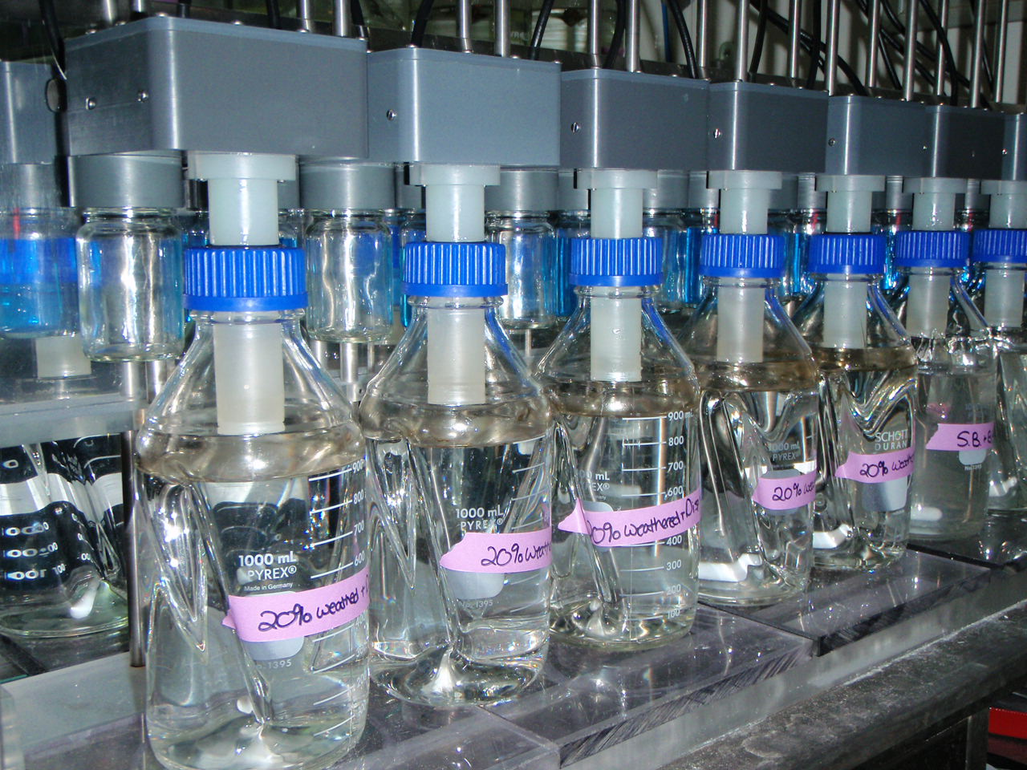
Respirometry
Notes:
% Loss = [((A0/H0) — (As/Hs)) / (A0/H0)] x 100
𝐵𝑂𝐷=𝑇𝑒𝑠𝑡 𝑆𝑢𝑏𝑠𝑡𝑟𝑎𝑡𝑒 𝑂𝑥𝑦𝑔𝑒𝑛 𝑈𝑝𝑡𝑎𝑘𝑒 𝑚𝑔 − 𝐵𝑙𝑎𝑛𝑘 𝑂𝑥𝑦𝑔𝑒𝑛 𝑈𝑝𝑡𝑎𝑘𝑒 (𝑚𝑔)𝑇𝑒𝑠𝑡 𝑆𝑢𝑏𝑠𝑡𝑎𝑛𝑐𝑒 𝑖𝑛 𝐹𝑙𝑎𝑠𝑘 (𝑚𝑔) Eq 1
The percent mineralization is then calculated by dividing the BOD by the ThOD.
% 𝑀𝑖𝑛𝑒𝑟𝑖𝑙𝑖𝑧𝑎𝑡𝑖𝑜𝑛= 𝐵𝑂𝐷 (𝑚𝑔 𝑜𝑥𝑦𝑔𝑒𝑛𝑚𝑔 𝑡𝑒𝑠𝑡 𝑠𝑢𝑏𝑠𝑡𝑟𝑎𝑡𝑒) 𝑇𝑕𝑂𝐷 (𝑚𝑔 𝑜𝑥𝑦𝑔𝑒𝑛𝑚𝑔 𝑡𝑒𝑠𝑡 𝑠𝑢𝑏𝑠𝑡𝑟𝑎𝑡𝑒)
**Manometric respirometry combined with GCMS total petroleum hydrocarbon (TPH) analysis was used to evaluate the biodegradation of chemically dispersed and physically dispersed petroleum.
Manometric respirometry measures oxygen consumption using a machine called a respirometer. In this closed system, respiration is measured as microorganisms utilized the oil as their carbon source and give off CO2. This CO2 is absorbed in this sodium hydroxide trap, which offsets the pressure equilibrium. The computer head, recognizes this difference in pressure and turns on an oxygen-generating electrolytic solution of copper sulfate, this blue jar. The created oxygen is then pumped into the attached flask. The amount of time that the electrolytic cell is creating oxygen, correlates to the amount of oxygen created. From there we can measure how much oxygen each treatment is consuming and calculating a rate of mineralization.
Biodegradation experiments utilized Alaska North Slope (ANS) crude oil and the chemical dispersant Corexit 9500.
Two seasonal biodegradation tests have been completed to date to determine the ability of indigenous microorganisms to degrade chemically dispersed and non-chemically dispersed crude oil in open water arctic conditions. The first test utilized microorganisms collected in October 2009 and the second collection occurred in March 2010.

Slide 59
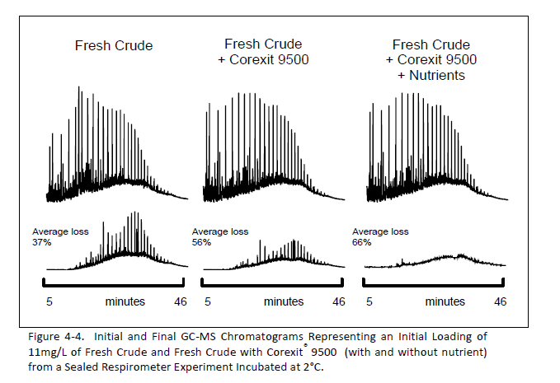

Slide 60
Biodegradation Results
All treatments listed above contain 0.5% of the recommended volume of Bushnell Haas, except the November 2009 study, in which ONLY one treatment of fresh oil + Corexit contains 1.0% Bushnell Haas
The 2009 data was weathered 24%, while the 2010 data was weathered 20%
Notes:
These are the final results of our 60 day biodegradation test.
More weathered oil was mineralized at -1C, when compared to 2C, due to a decrease in % weathered and the presence of a small amt of nutrients.
We performed 2 tests with weathered oil and 1 with fresh oil. This does not show our 2011 biodegradation data.
When Corexit was present primary biodegradation and mineralization increased, every time.
In the Corexit only treatment, more mineralization occurred, compared to oiled treatments.

Slide 61
Percent Mineralization of 24% Weathered Crude and Fresh Crude with and without the Dispersant Corexit® 9500 at a 1:20 DOR, Measured by Respirometry at 2°C using Arctic Seawater Collected in November 2009
Notes:
Figure 4-2. Percent Mineralization of 24% Weathered Crude and Fresh Crude with and without the Dispersant Corexit® 9500 at a 1:20 DOR, Measured by Respirometry at 2°C using Arctic Seawater Collected in November 2009
[In order to determine if the natural amount of nutrients in the seawater become a limiting factor to biodegradation in the 60 day closed system experiment, one treatment of fresh crude + Corexit® 9500 contains 1% of the recommended volume of Bushnell Hass. Gaps in data are due to unrecorded daily measurements.]

Slide 62
Biodegradation Results Summary
Microbes indigenous to the Arctic biodegrade both chemically and physically dispersed petroleum under Arctic conditions
Dispersants do not interfere with the extent of microbial biodegradation
Over an 8-week testing period, chemically dispersed fresh petroleum biodegrades more than physically dispersed or weathered petroleum.

Slide 63

Modeling

Slide 64
Peon on Microbial Ecology and Oil Spill Modeling
Microbes, such as bacteria, are ubiquitous on (and under) the earth. Which particular types are found depends on their environmental factors, such as carbon sources, energy, nutrients, and competitors. The participation of bacteria and their efficiency in vital ecological process such as: decomposition, nutrient cycling, and contaminant removal and the rates of these processes depends on the types of bacteria initially available and the environment. In general, hydrocarbons from oil in the marine environment are readily degraded because natural oil seeps and anthropogenic contamination have provided carbon and energy for the development of bacteria that utilize oil components. However in the event of a large oil spill on the surface or an undersea blowout questions arise about the rates of biodegradation and the limiting factors of nutrients and oxygen availability. The field of microbial ecology studies the relationship between bacteria and their environment. Because bacteria, even under a microscope, look basically the same, techniques of genetic analysis – DNA and RNA, and protein analysis are used to assess population types and their capacities to transform substrates, including contaminants such as oil. Using the techniques of microbial analysis one can answer questions regarding populations of bacteria present in various marine locations and the horizontal and vertical diversity within the marine environment. Analysis of the enzymes programmed by bacterial DNA allows extrapolation between bacteria from very different locations, such as between the Gulf of Mexico and the Arctic. Analysis of the nutrients and other environmental requirements may allow estimation of rates of biodegradation in various spill fate and transport scenarios.

Slide 65

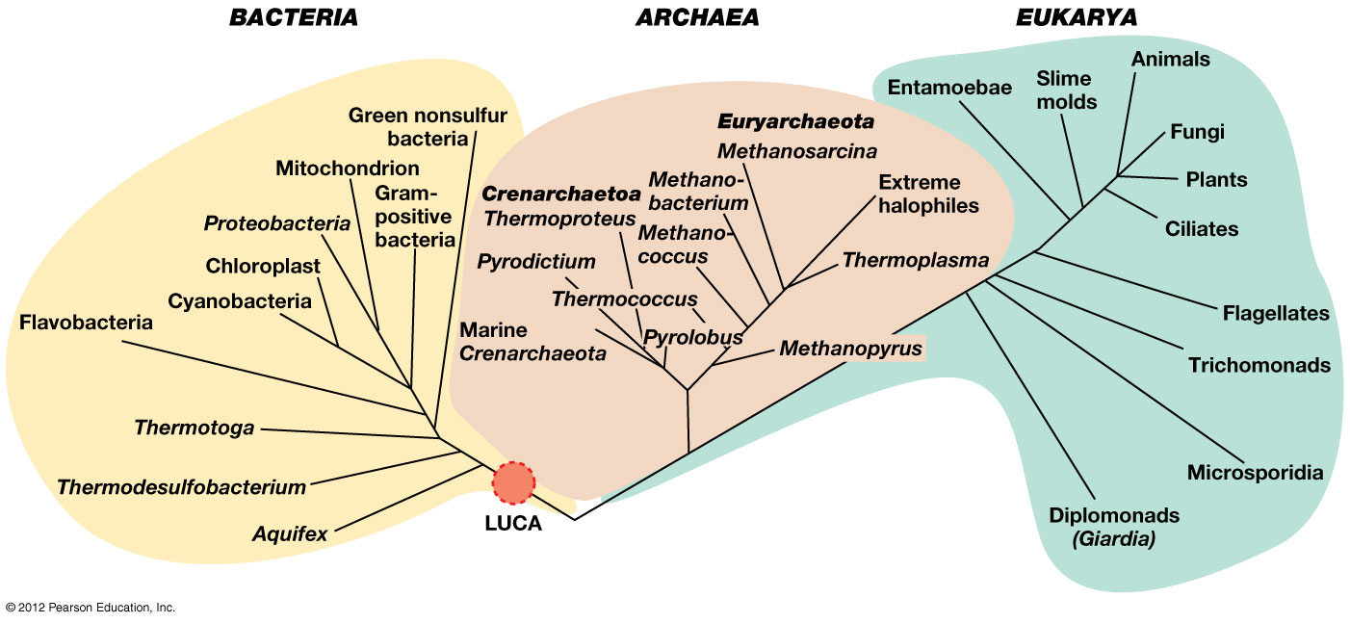
Microbes are the world’s best chemists
Notes:
Microbes are most numerous and diverse organisms, and have been here the longest
They perform many essential ecosystem services
Decomposition
Nutrient cycling
Contaminant removal
Aesthetic inspiration
…..

Slide 66
Microbes are the world’s best chemists
Notes:
Microbes are most numerous and diverse organisms, and have been here the longest
They perform many essential ecosystem services
Decomposition
Nutrient cycling
Contaminant removal
Aesthetic inspiration
…..

Slide 67
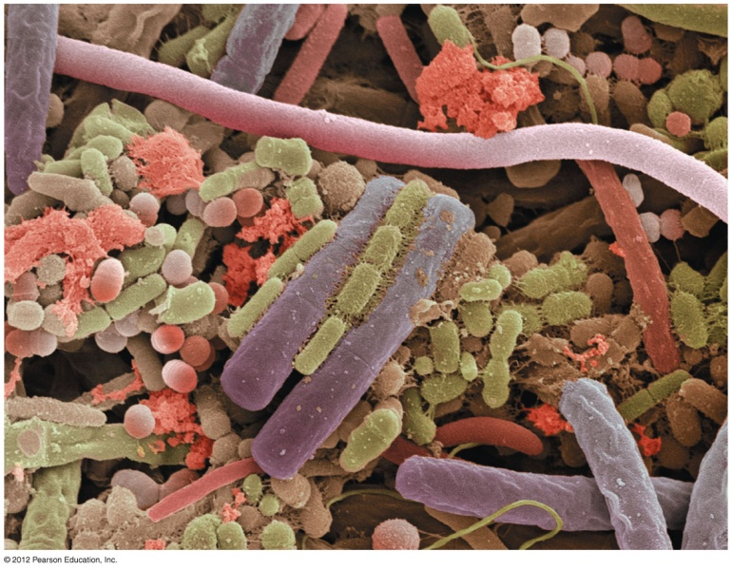
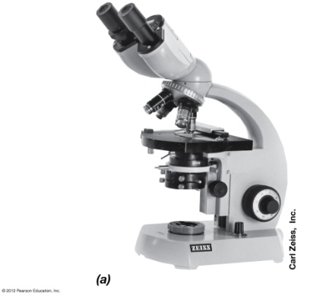
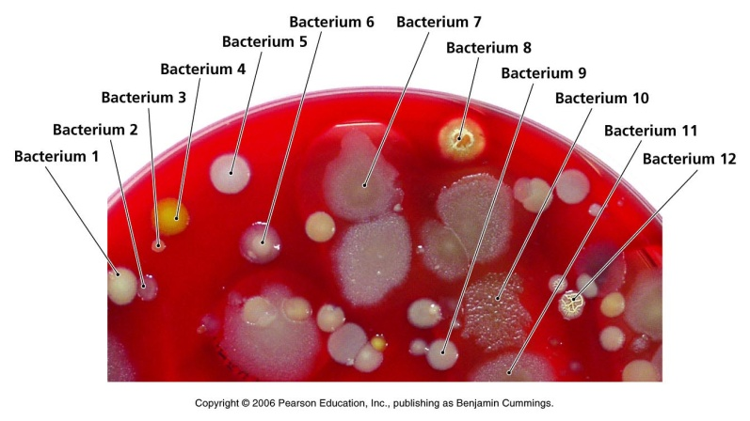
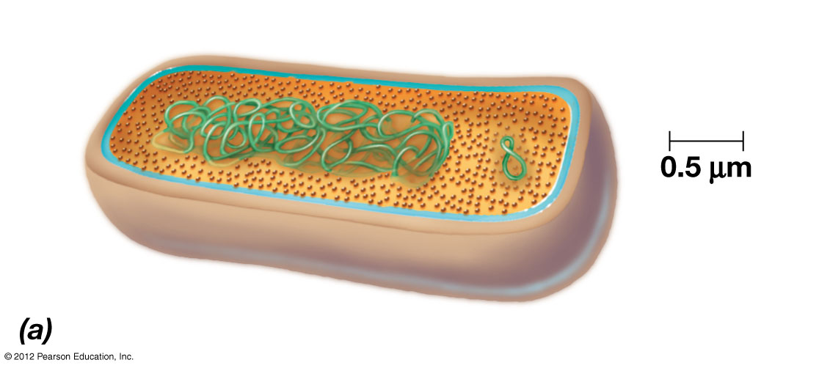
How do we study microbial communities?
Microscopy
Cultivation
Molecular markers
PLFA - phospholipid fatty acids
Quantity/diversity of major microbial groups
Gram +, Gram - , Fungi, Archaea
DNA: sequencing, microarrays
rRNA genes – “species” level identification
Functional genes – show what microbes can do (biodegradation, metabolism, etc.)
Proteins
RNA
Notes:
Community scraped from a human tongue (microscopy)

Slide 68
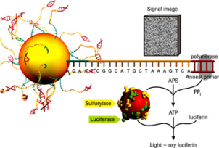
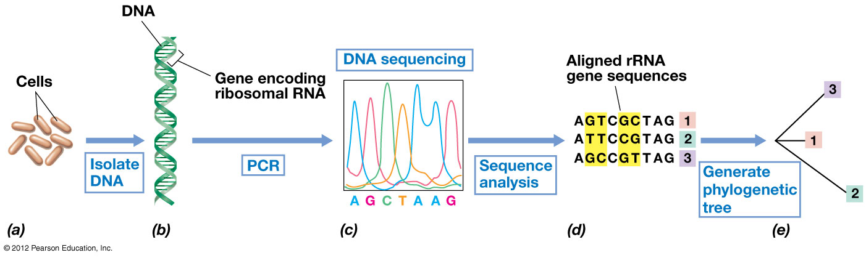
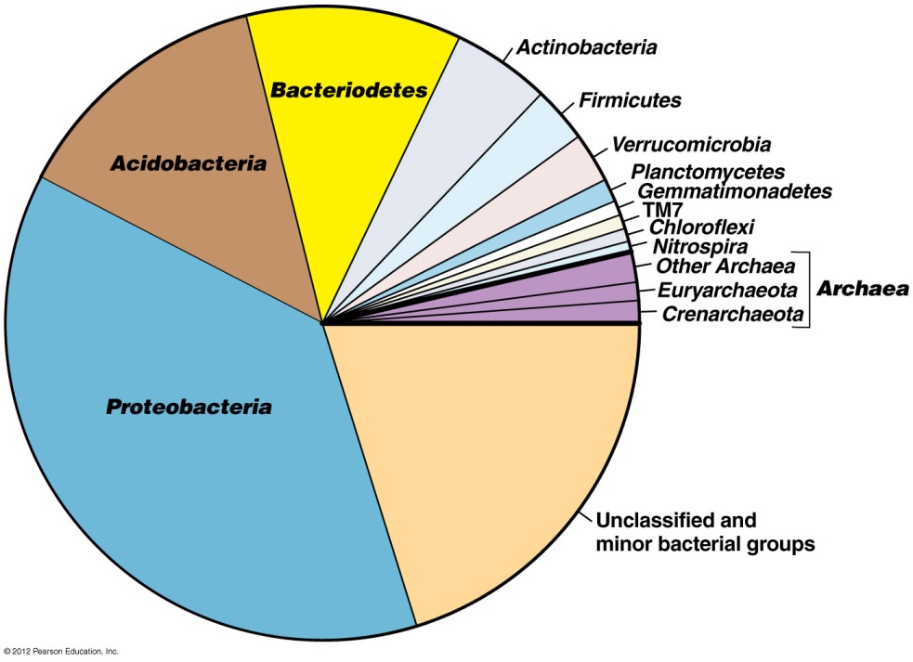
Bacterial community analysis using 16S rRNA sequencing
Pyrosequencing
Soil, water
Compare to databases for phylogenetic identification
Soil prokaryotic community composition and structure
Notes:
DNA Pyrosequencing to identify microorganisms
All bacteria have the 16S rRNA gene
Sequence thousands of these genes from our samples
Compare sequences to public databases
Reveals their phylogenetic identity, relative abundance in community

Slide 69
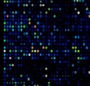

Microarrays - Methods
High throughput method for detection of presence and concentration of sequences
Short DNA probes that match known genes are spotted onto a matrix (i.e. glass microscope slide)
GeoChip microarray was designed using 50,000 different gene probes for microbial functions important in the environment

Slide 70
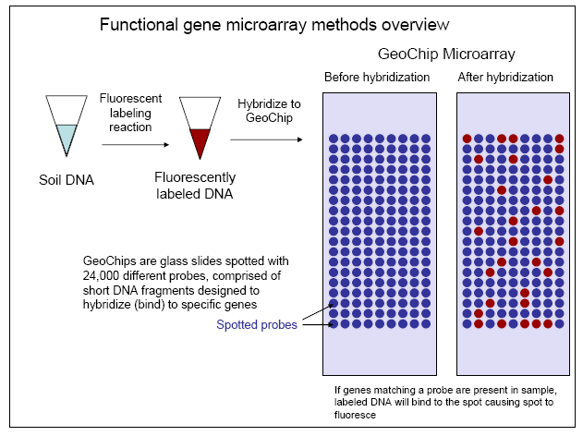
Zhou et al 2009
Notes:
C, N, S, P cycling genes, Organic contaminant degradation, Metal resistance and reduction
Advantage is that you don’t need to know a microbial profile.

Slide 71
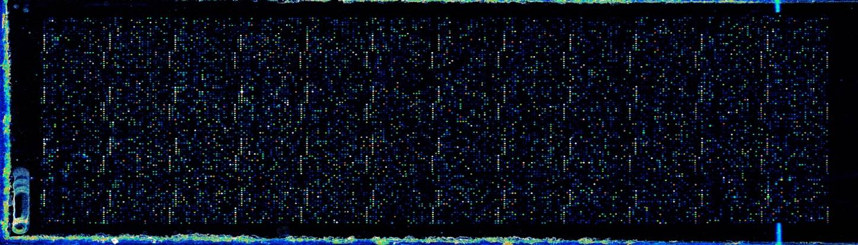
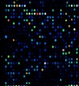
GeoChip Microarray - Methods
Cy5: Environmental Sample
Notes:
Two images of one slide at different wavelengths.
Each sample is labeled with Cy5 dye, and includes a Cy3 universal standard (made up by the lab, will bind with every probe).
No replication of genes, however there is the positive control for each of the grids (16S)
Discuss genes are measured as Signal intensity. Higher intensity means that there is more of that gene present. Signal intensity is normalized within each spot.

Slide 72
Methods: Summary of probes on the GeoChip microarray
Gene Category | No. of genes/enzymes | No. of probes | Sequence-specific probes | Group-specific probes | Covered CDS
Carbon cycling | 41 | 5196 | 1765 | 3431 | 10573
Nitrogen (N) cycling | 16 | 3763 | 2148 | 1615 | 7839
Phosphorus (P) utilization | 3 | 599 | 183 | 416 | 1220
Sulfur (S) cycling | 4 | 1504 | 1083 | 421 | 2042
Metal resistance | 41 | 4870 | 603 | 4267 | 10962
Organic contaminant degradation | 173 | 8614 | 2165 | 6449 | 17441
Antibiotic resistance | 11 | 1594 | 265 | 1329 | 3944
Phylogenetic marker (gyrB) | 1 | 1164 | 629 | 535 | 1198
Total | 292 | 27816 | 9251 | 18561 | 56990
He et al 2010
Notes:
Be sure to explain each of the columns
41 enzymes, but 10K different variations on that enzyme.
GeoChip can detect functional genes in an environmental sample. 47,000 different gene
#Genes: # genes for different types of carbon degradation represented.
#probes: are the different probes for varying moo for each gene.
#unique probes: smaller number because some probes can be used more than once for different types of moo
#group probes: actual number of probes for groups (not individuals, more coverage of genera)
#CDS: total number of individual types of functional groups covered.
I will specifically look at the organic remediation gene category for my thesis (but we will be able to mine this data for lignocelluloses degradation and other projects going on in the lab).

Slide 73
Microbial research methods: Advanced molecular genetic tools
    GeoChip microarray detects thousands of different microbial genes for biodegradation (biodegradative potential)…

Slide 74
Friends and Partners
CROSERF
  Seward Marine Center
  SeaLife Center
Current work with Creosote in Southeast
  UAS
  NOAA NMFS
JIP
Shell, ExxonMobil, Statoil, Conoco

Slide 75
TAC of JIP
NOAA
BOEMRE
EPA
ADEC
COOGER
  Centre for Offshore Oil, Gas and Energy Research
  Fisheries and Oceans Canada
SINTEF
  Joint industry program on oil spill contingency for Arctic and ice covered waters

Slide 76
Experience and Capability
Arctic Marine Tox and Biodegredation
Barrow Lab
  Set up lab
  HSE issues
  IACUC
  BASC, administration
  NSB Wildlife, others

Slide 77


NewFields NW

Slide 78






Arctic Species Sensitivity Distribution
Gro Harlaug Olsen, Lionel Camus, Mathijs Smit, Tim Smith,
Iris Jæger, JoLynn Carroll,

Slide 79



Acknowledgements
Funding provided by: Shell, ExxonMobil, StatOill, ConocoPhillips for Barrow works and BP and Alaska and US DOT for Creosote . Special thanks to BASC and our North Slope friends and helpers.

Slide 80

Questions, Discussion

